Slide 1
CHAPITRE VIROLOGIE PARTIE 2

Slide 2

THE LYTIC LIFE CYCLE OF COLIPHAGE T4 CONSISTS OF THE FOLLOWING STEPS:
1. Adsorption
Attachment sites on the bacteriophage tail adsorb to receptor sites on the cell wall of a susceptible host bacterium.
2. Penetration
A bacteriophage enzyme "drills" a hole in the bacterial cell wall and the bacteriophage injects its
genome into the bacterium (Fig. 3). This begins the eclipse period, the period in which no intact bacteriophages are seen within the bacterium.
3. Replication
Enzymes coded by the bacteriophage genome shut down the bacterium's macromolecular (protein, RNA, DNA) synthesis. The bacteriophage genome replicates and the bacterium's metabolic machinery is used to synthesize bacteriophage enzymes and structural components
4. Maturation
The bacteriophage parts assemble around the genome .
5. Release
A bacteriophage-coded lysozyme breaks down the bacterial peptidoglycan causing osmotic lysis of the bacterium and release of the intact bacteriophages.
6. Reinfection
From 50-200 bacteriophages may be produced per infected bacterium and they now infect
surrounding bacteria.

Slide 3
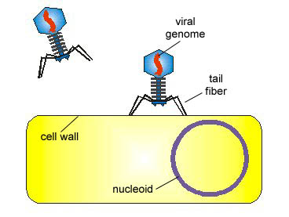
Penetration:The bacteriophage injects its DNA genome into the
cytoplasm of the bacterium.
Early replication: The genome of the bacteriophage replicates and
begins to direct the metabolic machinery of the bacterium to produce phage structural components
Adsorption:Tail fibers of Coliphage T4 adsorb to receptors on
the cell wall of E. coli B.
Late replication: early maturation
Phage parts continue to be produced and begin to
assemble.
Maturation:
The phage parts assemble producing intact bacteriophage
Release:
Phage-coded lysozyme breaks down the bacterium’s cell wall causing lysis. The bacteriophages are released.

Slide 5
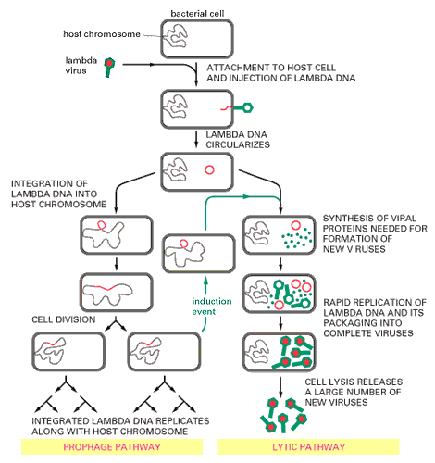
Multiplication des phages

Slide 6
VIRUS VIRULENT OU TEMPERE?
Prokaryotic viruses which display a latent phase are called “temperate”, or “lysogenic”. The term lysogenic refers to a host phenotype: the bacteria can be spontaneously lysed by the latent phage.
Bacteria such as E. coli and Salmonella contain multiple resident proviruses whose variability in number and type constitutes a major source of diversity between strains .
Prokaryotic proviruses usually carry cargo genes encoding traits adaptive to the host, among which are virulence factors found in many bacterial pathogens.

Slide 7
VIRAL LATENCY (LATENCE VIRALE)
Viral latency is the ability of a virus to remain dormant within the host cell, sometimes establishing lifelong occult infection. Depending on the virus, the trigger of latency is highly variable but the host cell context is always determining. Latency can stop upon viral genome reactivation, often promoted by stress cellular signals.
The viral genome can remain latent either as an episome or integrated in the host chromosome. The latter allows replication of the viral genome during host cell division. Virus latency is generally maintained by a few viral genes that keep the viral genome silent and escape from host immune system.
Eukaryotic viruses like some Herpesviridae or Retroviridae are able to infect their host lifelong thanks to latency. This gives them an enormous advantage for disseminating in their host population: about 90% of human population would be infected with varicella-zoster virus.

Slide 8
LATENCE OU LYSE CELLULAIRE ?
Viruses that have the ability to lie latent within a cell have two options when infecting a cell: they can either enter the latency or the lytic pathway.
The decision between lytic and latent pathways is regulated by expression of regulatory proteins part of a genetic switch system, usually repressor(s) as well as proteins controlling the stability of the later.
The outcome of the followed pathways depends on the ratio of these key regulators. This ratio may be determined by environmental factors such as the host cell type, its shape, or the nutriment availability.
A well known genetic switch system is the one of bacteriophage lambda which includes at least a repressor of the lytic promoter, a repressor of the latency promotor and two key regulators

Slide 9
VIRAL LATENCY (LATENCE VIRALE)
VIRUS | FAMILY | GENERA | LATENT REPLICATION FORM | MAIN SITE OF LATENCY
HHV-1, HHV-2 | Herpesviridae | Simplexvirus | Circular episome | Dorsal root ganglia
HHV-3 | Herpesviridae | Varicellovirus | Circular episome | Dorsal root ganglia
HHV-4 | Herpesviridae | Lymphocryptovirus | Circular episome | Memory B-cells
HHV-5 | Herpesviridae | Cytomegalovirus | Circular episome | Myeloid progenitor cells
HHV-6 | Herpesviridae | Roseolovirus | Probable telomeric integration | Monocytes (HHV-6B)
HHV-7 | Herpesviridae | Roseolovirus | Circular episome | CD4+ T-cells
HHV-8 | Herpesviridae | Rhadinovirus | Circular episome | B-cells
HIV-1 | Retroviridae | Lentivirus | Provirus | Memory T-cells
HTLV-1 | Retroviridae | Deltaretrovirus | Provirus | Memory T-cells

