Slide 1

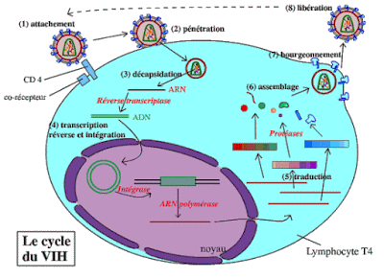
Cycle de vie du VIH

Slide 2
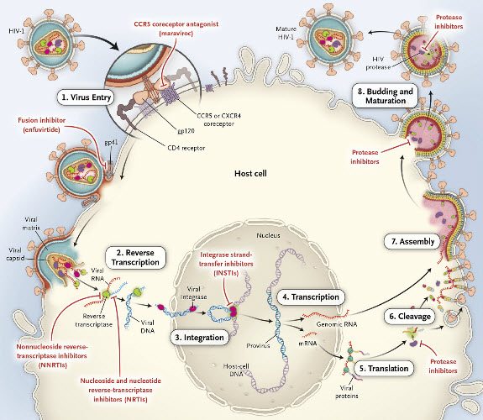

Slide 3
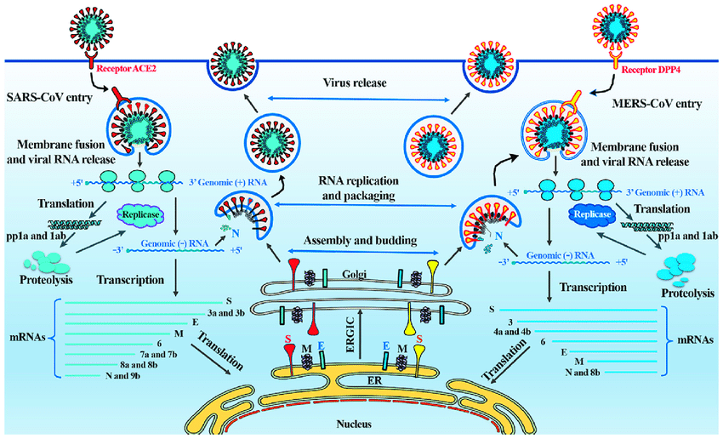
The life cycle of SARS-CoV and MERS-CoV in host cells. SARS-CoV and MERS-CoV enter target cells through an endosomal pathway. The S proteins of SARS and MERS bind to cellular receptor angiotensin-converting enzyme 2 (ACE2) and cellular receptor dipeptidyl peptidase 4 (DPP4), respectively. Following entry of the virus into the host cell, the viral RNA is unveiled in the cytoplasm. ORF1a and ORF1ab are translated to produce pp1a and pp1ab polyproteins, which are cleaved by the proteases that are encoded by ORF1a to yield 16 non-structural proteins that form the RNA replicase-transcriptase complex. This complex drives the production of negative-sense RNAs [(−) RNA] through both replication and transcription. During replication, full-length (−) RNA copies of the genome are produced and used as templates for full-length (+) RNA genomes. During transcription, a subset of 7-9 sub-genomic RNAs, including those encoding all structural proteins, is produced through discontinuous transcription. Although the different sub-genomic mRNAs may contain several open reading frames (ORFs), only the first ORF (that closest to the 5′ end) is translated. Viral nucleocapsids are assembled from genomic RNA and N protein in the cytoplasm, followed by budding into the lumen of the ERGIC (endoplasmic reticulum (ER)-Golgi intermediate compartment). Virions are then released from the infected cell through exocytosis. SARS-CoV, severe acute respiratory syndrome coronavirus; MERS-CoV, Middle East respiratory syndrome coronavirus; S, spike; E, envelope; M, membrane; N, nucleocapsid

Slide 4
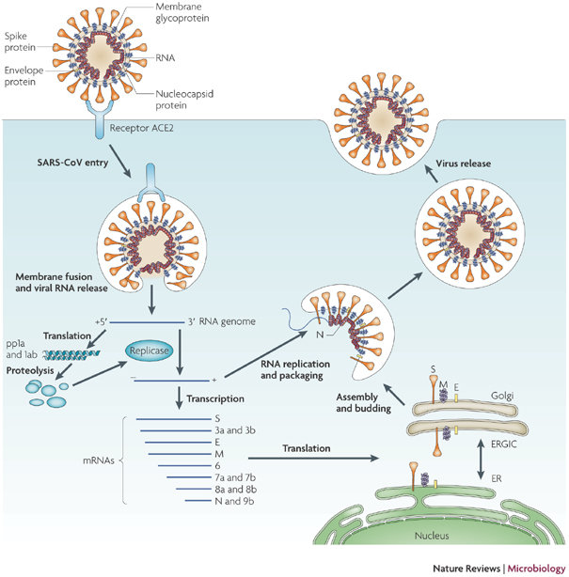
MULTIPLICATION DU CORONA VIRUS

Slide 5
HIV-1 protease (PR) is a retroviral aspartyl protease (retropepsin), an enzyme involved with peptide bond hydrolysis in retroviruses, that is essential for the life-cycle of HIV, the retrovirus that causes AIDS.
HIV protease cleaves newly synthesized polyproteins (namely, Gag and Gag-Pol) at nine cleavage sites to create the mature protein components of an HIV virion.
Without effective HIV protease, HIV virions remain uninfectious.

Slide 6
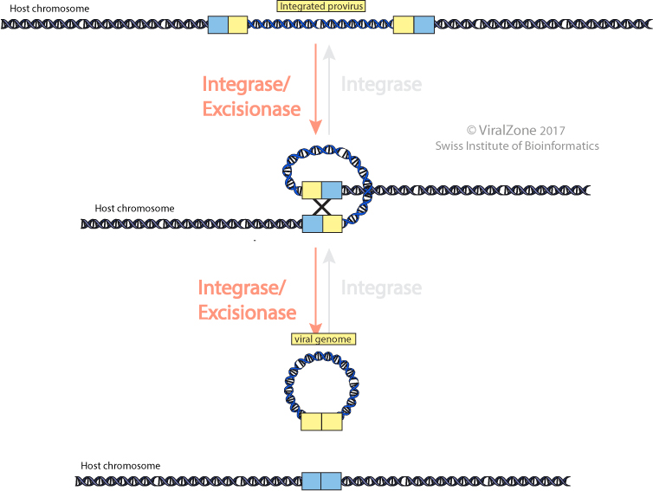
Viral genome excision
Most temperate phages encode an integrase for both integration and excision. Excision may require an accessory protein called excisionase or recombination directionality factor to promote excision .
Excision is the recombination event that leads to the release of a viral genome that was formerly integrated into the host DNA chromosome as a provirus. This release is usually induced upon changes in the host cell physiology (induction).
NB. Aberrant excision may occur. Small pieces of bacterial DNA may become excised and packaged into the bacteriophage capsid together with the bacteriophage genome.
This exchange of genetic information is called transduction. .

